Slide 1
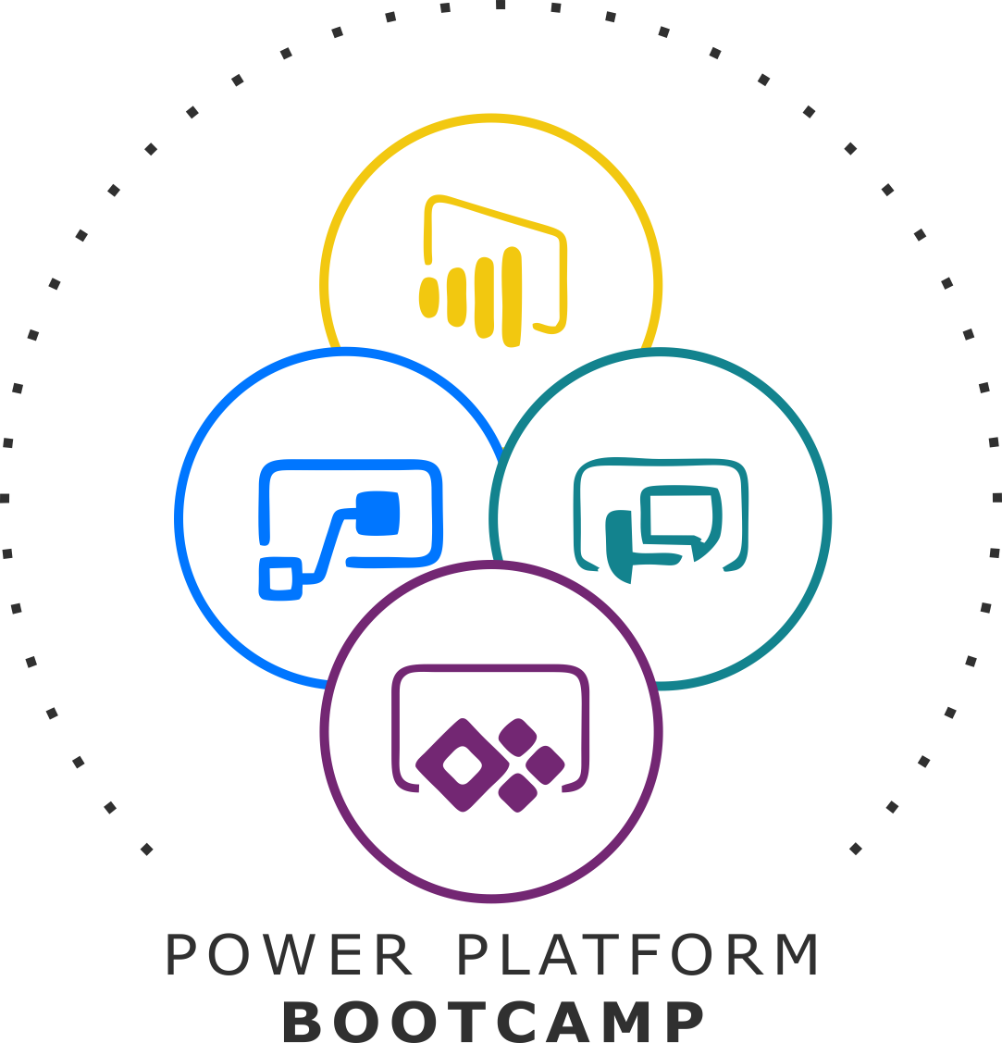
GLOBAL POWER PLATFORM BOOTCAMP
Organized Globally, Held Locally
@GPPBootcampBLR #GPPBootcampBLR #GlobalPowerPlatformBootcamp

Slide 2

Managing and Supporting Power Apps and Power Automate
Radhakrishnan Govindan
Microsoft 365 Consultant, MCT, rMVP
@Softkrishnan
@GPPBootcampBLR #GPPBootcampBLR
#GlobalPowerPlatformBootcamp

Slide 3

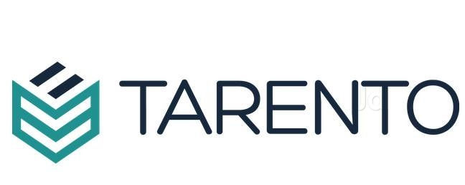

Sponsors

Slide 4
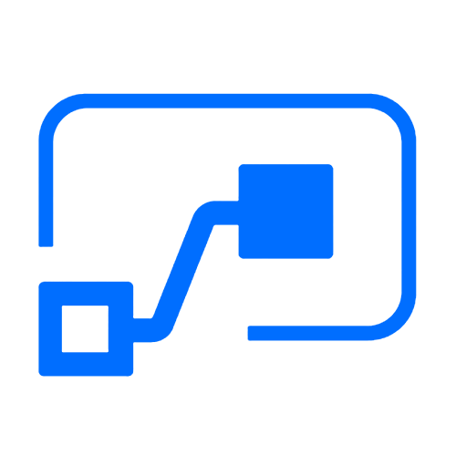



Who here has a Microsoft 365 background?
SharePoint, Teams, Exchange…
Microsoft 365
Analyze
Act
Automate
Data connectors
Microsoft Power Automate
Workflow automation
Standalone apps
Power BI
Business analytics
Power Apps
Low-code/no-code application development
Common Data
Service
AI Builder

Slide 5
What about a Dynamics 365 background?
Sales, Service, Talent…
Microsoft 365
Dynamics 365
Analyze
Act
Automate
Data connectors
Microsoft Power Automate
Workflow automation
Standalone apps
Power BI
Business analytics
Power Apps
Low-code/no-code application development
Common Data
Service
AI Builder

Slide 6
Last, but not least, what about Azure?
Azure SQL, Azure Functions…
Microsoft 365
Dynamics 365
Microsoft Azure
Analyze
Act
Automate
Data connectors
Microsoft Power Automate
Workflow automation
Standalone apps
Power BI
Business analytics
Power Apps
Low-code/no-code application development
Common Data
Service
AI Builder

Slide 7
Best
Practices
Agenda
Establish an environment strategy
Setup data loss prevention policies
Leverage out-of-box activity logs & analytics
Secure your tenant
Monitor your tenant’s activity
Alert & act on that activity

Slide 8
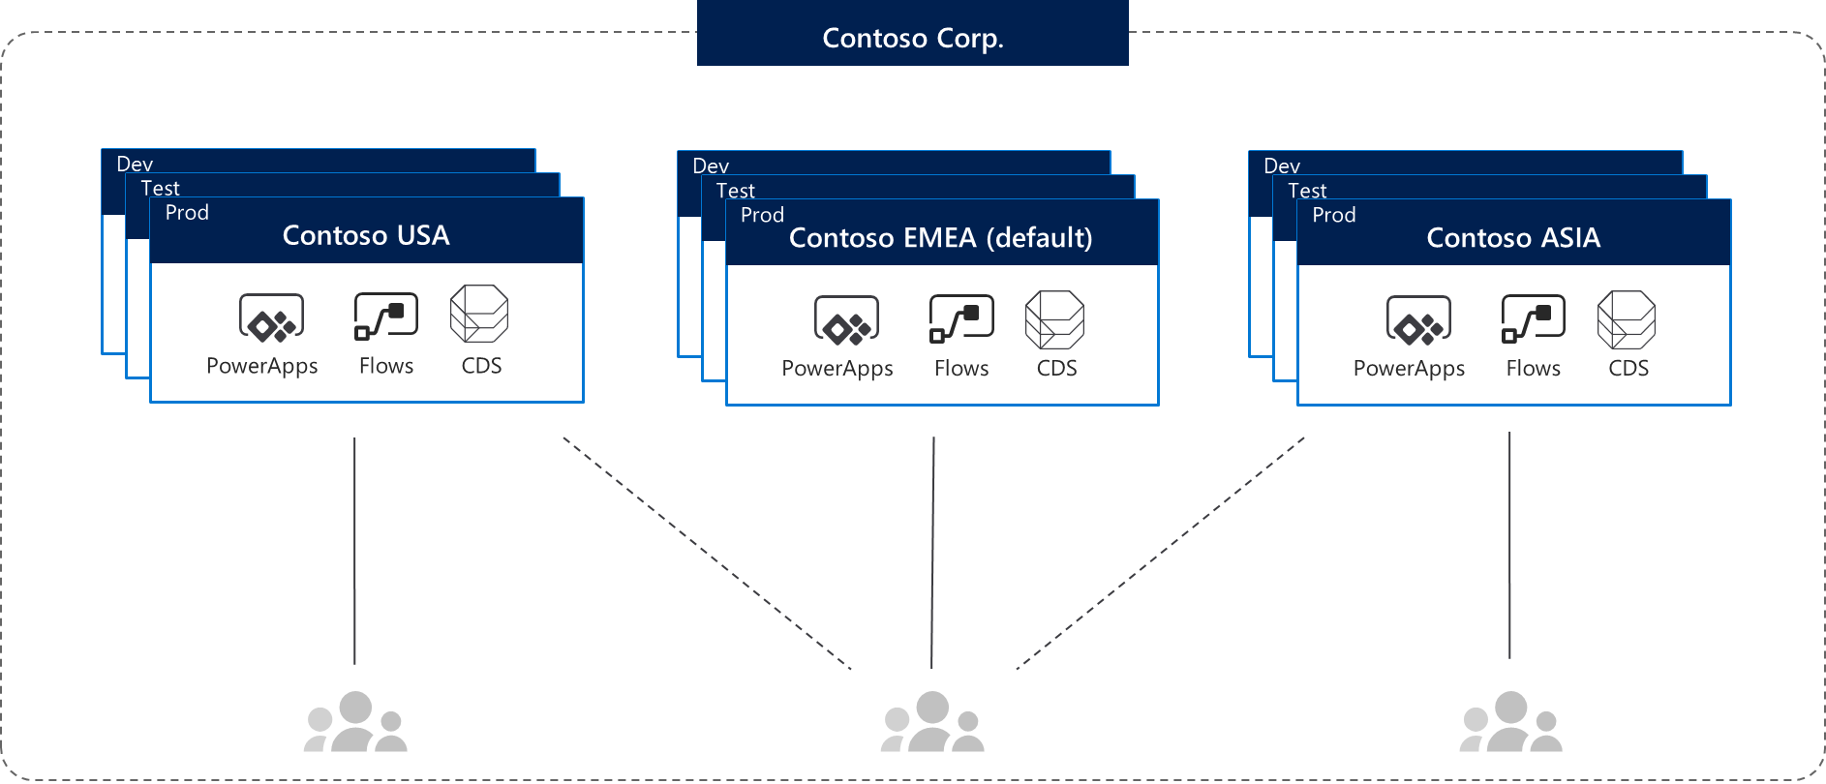
Environments
Environments are containers that administrators can use to manage apps, flows, connections, and other assets; along with permissions to allow organization users to use the resources
Azure AD Tenant
Environments
1. Product discovery
2. Know your Environments
3. 5+1 security layers
4. Setup DLP policies
5. Configure audit logs
6. Review Analytics
7. Automate your reports
8, Automate your polices
9. Proactive engagement
10. CoE toolkit

Slide 9
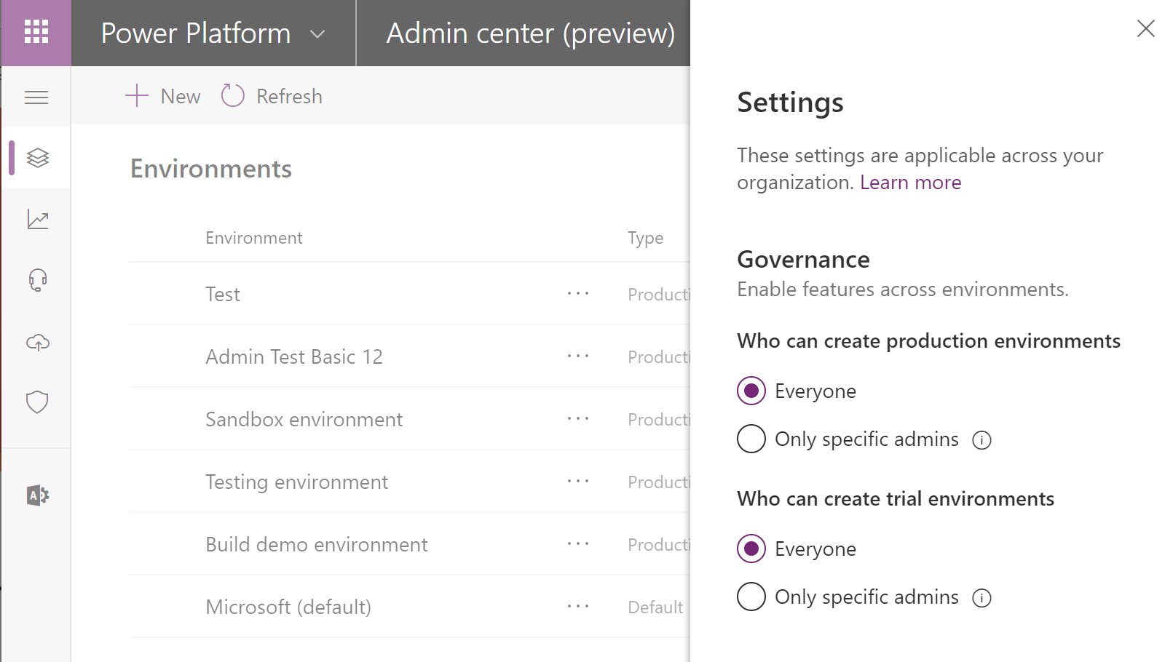
Environment key facts
Environments are tied to a geographic location that is configured at the time the environment is created
Environments can be used to target different audiences and/or for different purposes such as dev, test and production
Every tenant has a Default environment where all licensed Power Apps and Power Automate users can create apps & flows
Non-default environments offer more control around permissions
Non-default environment creation can be restricted to only global and service admins from the Power Platform admin center: https://aka.ms/ppac

Slide 10
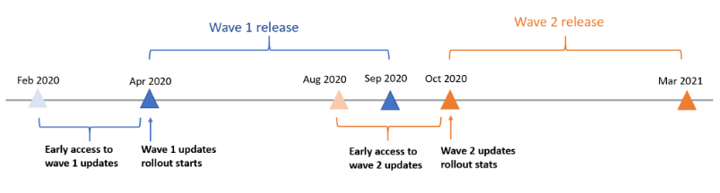
opt in to early access updates..
Best practice is to enable the updates in trial or sandbox environments before production environments.
For each of the major releases, you can opt in for early access updates approximately two months before
the major release is automatically enabled in your region.

Slide 11
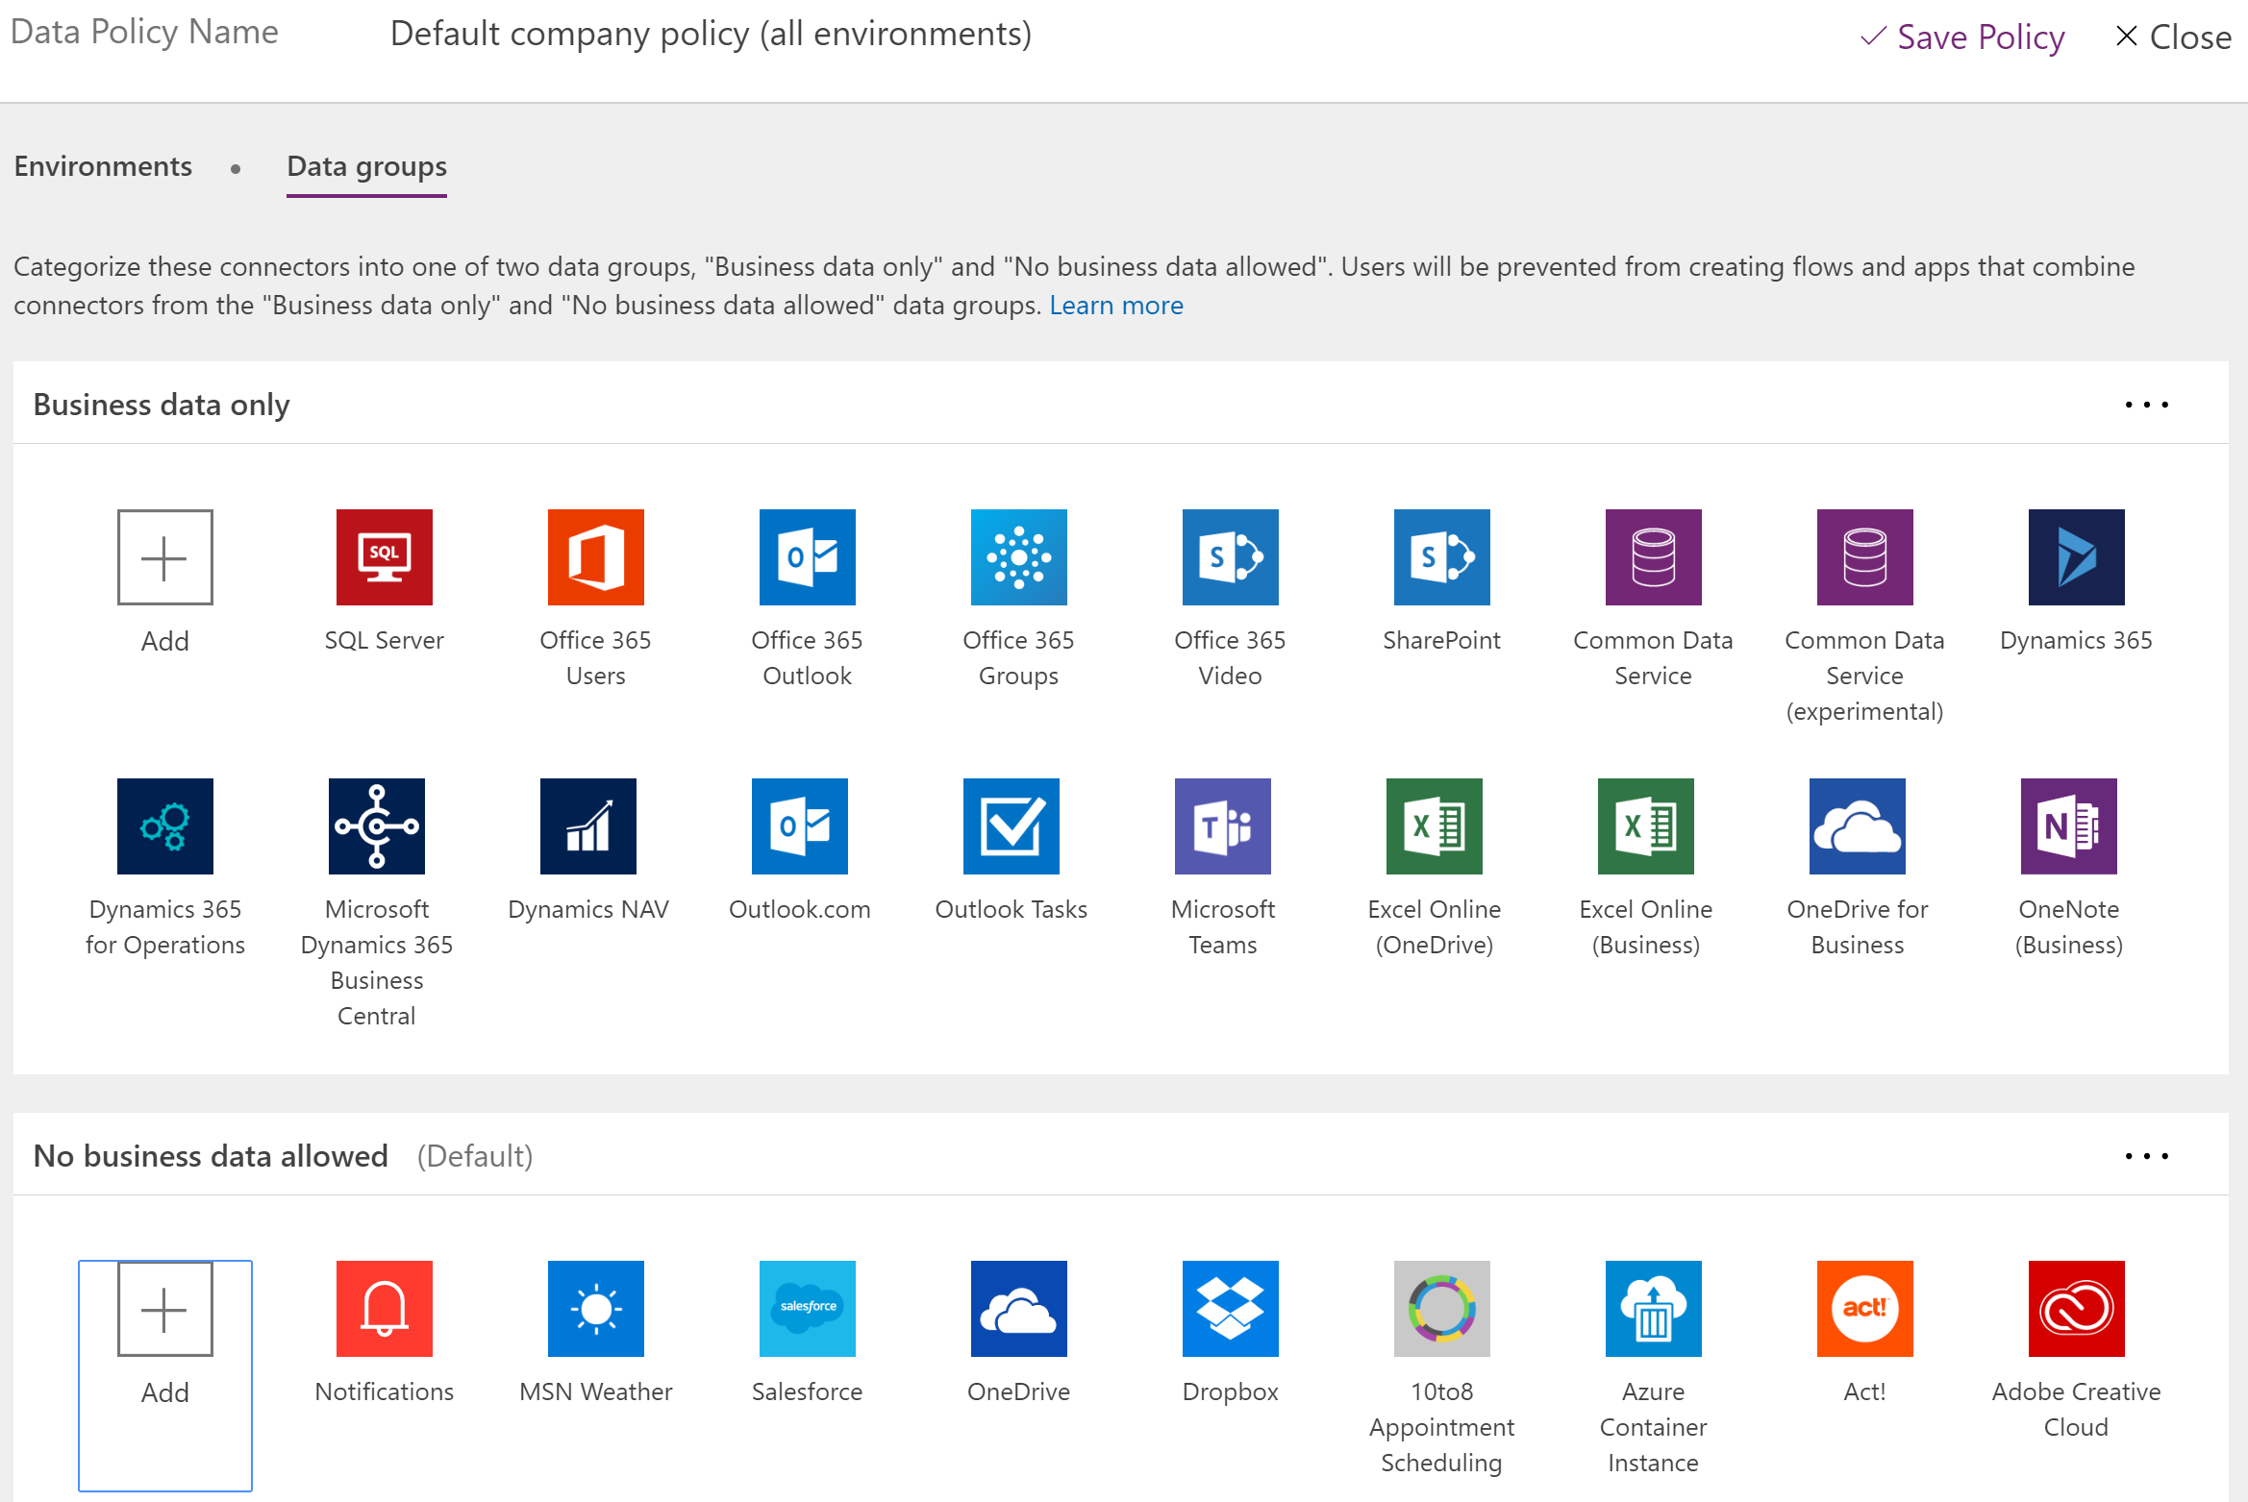
Data loss prevention key facts
Data loss prevention policies (DLP) enforce rules for which connectors can be used together
Connectors are classified as either Business Data only or No Business Data allowed
A connector in the business data only group can only be used with other connectors from that group in the same app or flow
Tenant admins can define policies that apply to all environments
Coming CY19: Non-Microsoft connectors can fully blocked using DLP policies

Slide 12
Setup data loss prevention (DLP) policies
Create a policy spanning all environments that blocks all unsupported non-Microsoft connectors and classifies all Microsoft connectors as ‘Business Data’
Best
Practice
#2
#1: Block unsupported non-Microsoft connectors (e.g. Dropbox, social media)
Default
Training #1
Training #2
Dev
Dev
Test
Test
Prod
Prod
Contoso Europe
Contoso USA

Slide 13
Setup data loss prevention (DLP) policies
Create a policy spanning all environments that blocks all unsupported non-Microsoft connectors and classifies all Microsoft connectors as ‘Business Data’
Create a policy for the default environment (and other training environments) that further restricts which Microsoft connectors are classified as ‘Business Data’
Best
Practice
#2
#1: Block unsupported non-Microsoft connectors (e.g. Dropbox, social media)
#2: Restrict ‘business data’ connectors (e.g. only Office 365 connectors are business data)
Default
Training #1
Training #2
Dev
Dev
Test
Test
Prod
Prod
Contoso Europe
Contoso USA

Slide 14
Setup data loss prevention (DLP) policies
Create a policy spanning all environments that blocks all unsupported non-Microsoft connectors and classifies all Microsoft connectors as ‘Business Data’
Create a policy for the default environment (and other training environments) that further restricts which Microsoft connectors are classified as ‘Business Data’
Create additional policies or exclude those environment from policies #1 and #2 above that permit certain connectors or connector combinations to be used for specific environments
#1: Block unsupported non-Microsoft connectors (e.g. Dropbox, social media)
#2: Restrict ‘business data’ connectors (e.g. only Office 365 connectors are business data)
#3: Create exception policies for certain application environments
Best
Practice
#2
Default
Training #1
Training #2
Dev
Dev
Test
Test
Prod
Prod
Contoso Europe
Contoso USA

Slide 15
Demo
Environment controls and data loss prevention policies

Slide 16
Monitor your tenant’s activity

Slide 17
Logs & analytics – see what’s happening
1. Power Apps and Power Automate logs available at https://protection.office.com
Best
Practice
#3
Activity Logging integrated with Office Security and Compliance center for comprehensive logging across Microsoft services
The audit records are stored in Office 365 Security and Compliance center.
Must have an Office 365 E3 or greater license
Must enabled at the organization level
Office provides an API to query this data, which is currently used by many SIEM vendors to use the Activity Logging data for reporting
Microsoft Power Automate | Power Apps
Created flow Edited flow Deleted flow Edited permissions Deleted permissions Started a paid trial Renewed a paid trial | Created app Edited/save app (draft) Published app Deleted app Restored an app from app version Launched app Marking app as featured Marking app as hero Edited app permissions Deleted app permissions

Slide 18
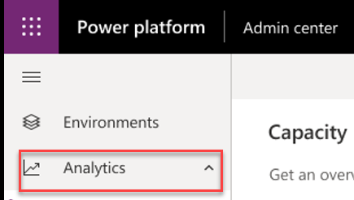
Logs & analytics – see what’s happening
1. Power Apps and Power Automate logs available at https://protection.office.com
2. Admin analytics
Tenant and environment level analytics
Available from Power Platform admin center
Access is available for environment admins
Data is stored for 28 days
Data is refreshed daily
https://aka.ms/ppac
Capacity Management
Common Data Service
Best
Practice
#3
Microsoft Power Automate
Power Apps

Slide 19
Logs & analytics – see what’s happening
Best
Practice
#3
1. Power Apps and Power Automate logs available at https://protection.office.com
2. Admin analytics
Tenant and environment level analytics
Available from Power Platform admin center
Access is available for environment admins
Data is stored for 28 days
Data is refreshed daily
3. Maker analytics (Canvas app and flow level analytics)
Available from make.Power Apps.com and flow.microsoft.com
Access is available to app & flow owners (admins can grant themselves
access)
Data is stored for 30 days
Data is refreshed daily
https://aka.ms/ppac
Capacity Management
Common Data Service
Microsoft Power Automate
Power Apps

Slide 20
Center of Excellence Toolkit
Best
Practice
#4
Download here now https://aka.ms/COEStarterKit
Step | Scenario | Toolkit Component
Secure​ | DLP Editor | Canvas App - DLP Editor​
Monitor​ | Flow templates to collect data into CDS​ Power BI Dashboards​ | CDS Entities​: Environments, Apps, Flows… Power Automate - Sync resources template​ Power Automate - Sync audit logs Power BI Dashboard Custom Connector for Office 365 Audit Logs
Alert & Action​ | Maker and Admin notification via Power Automate templates (Compliance request)​ Admin Model Driven App facilitates app audit process​ | Canvas App - Developer Compliance Center​ Power Automate - Compliance detail request​ Model Driven App​ - Business Process Flow for Auditing resources
Nurture​ | App catalog​ Welcome email, Internal community channel links​ | Canvas App - App Catalog Power Automate - Welcome Email​

Slide 21
Demo
Admin analytics reports &
CoE starter kit Power BI dashboard

Slide 22
Alert & act on that activity

Slide 23


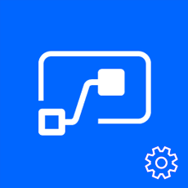

Leverage management connectors & PowerShell as powerful reporting tools + tools for action
The PowerShell Cmdlets give admins full visibility to all activity for Power Apps and Power Automate in their organization - aka.ms/Power Appspowershell.
Management connectors
Full visibility: Power Platform APIs in an accessible connector interface, provide admin access to resources
Customization : Pull the metadata you need to build the custom reports you want
Flexibility: Build the policies you need to implement administration + governance requirements
Power Platform for Admins
Power Apps for Admins
Power Automate Management
Power Apps for App Makers

Slide 24
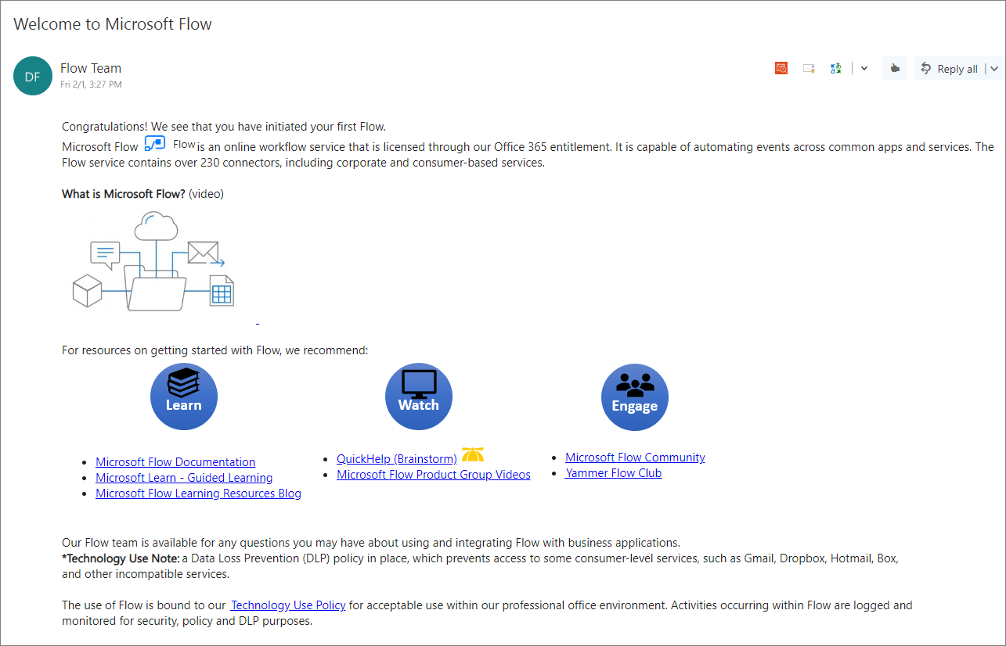
Welcome new makers and identify champions
Welcome new makers
Detect when new flow has been created
Check to see if they are part of makers AAD Group
If new, send welcome email with company and public resources
Invite them to Internal Yammer Club
https://aka.ms/powerwelcomeemail
Best
Practice
#5

Slide 25
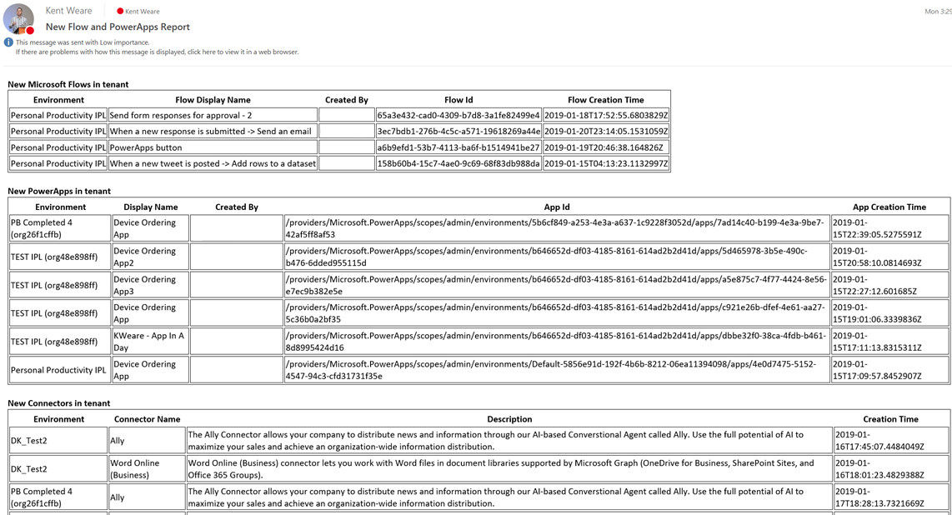
Welcome new makers and identify champions
Best
Practice
#5
Welcome new makers
Detect when new flow has been created
Check to see if they are part of makers AAD Group
If new, send welcome email with company and public resources
Invite them to Internal Yammer Club
https://aka.ms/powerwelcomeemail
Identify champions
New Power Automate, Power Apps and Connectors Digest
Sent Daily
Oversight
Empower new users
https://aka.ms/newmakerdigest

Slide 26
Establish and automate your audit process
Best
Practice
#6
Create your own workflows using the management connectors that permit or restrict behavior based on your organization’s policies (e.g. create an attestation process for assets in the default env)
Canvas app, flow creation | aka.ms/restrictappcreators
Specific connector usage | aka.ms/restrictflowconnector aka.ms/restrictappconnector
Newly added connectors | aka.ms/newconnectornotification

Slide 27
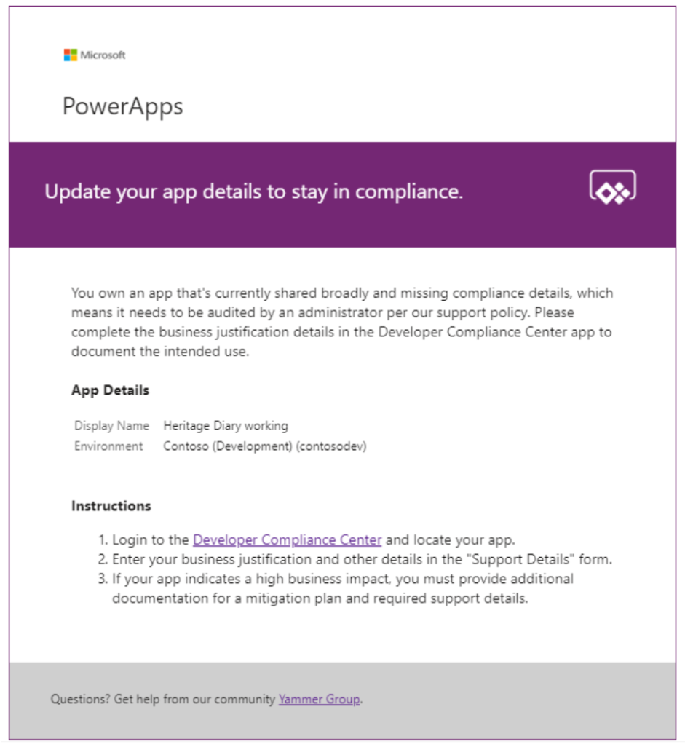
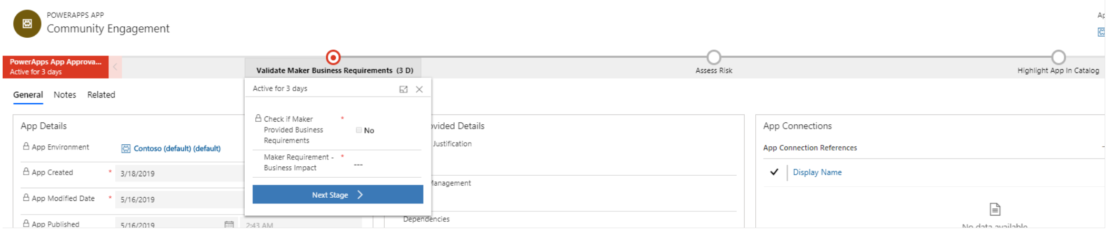
Establish and automate your audit process
Create your own workflows using the management connectors that permit or restrict behavior based on your organization’s policies (e.g. create an attestation process for assets in the default env)
Best
Practice
#6
CoE starter kit comes with its own audit workflow:
Apps are identified by a flow based on criteria such as the app is shared with > 20 Users or at least 1 group and the business justification details have not been provided.
Developer Compliance Center where the maker can provide a justification
Admin business process workflow for approval

Slide 28
Demo
CoE starter kit welcome email and audit process

Slide 29
Recap
Best
Practices
Establish an environment strategy
Setup data loss prevention policies
Leverage out-of-box activity logs & analytics
Secure your tenant
Monitor your tenant’s activity
Alert & act on that activity

Slide 30
Any Questions?

Slide 31
Building LOB Apps Uisng Microsoft Powerapps and Power Automate
Next Session:
Lalit Mohan
Sharepoint Specialist, Allegion

